Slide 1


Department of
Computer Science & Engineering
(Estd. 2001)
Accredited by NBA and NAAC with ‘A’ Grade

Slide 2
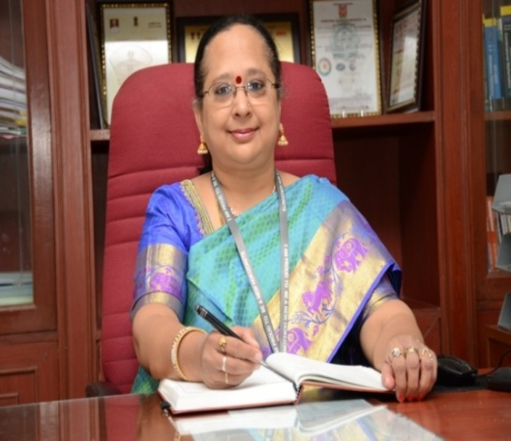
HOD - PROFILE
Dr. B. Rajalakshmi,
B.E (Hons), M.E, Ph.D, CICTT
Area of Research – Software Engineering
31 years of teaching, research and industrial experience
Published papers in ACM and Microsoft academic journal
Professional membership – CSI, ISTE
Sponsored projects – 15 lakhs from AICTE
BEST HOD award, 2007 for academic excellence
First faculty from India to receive the prestigious “Cambridge International Certification for teachers and trainers” –
University of Cambridge, UK, 2009
BEST paper award, International Conference on cloud computing and services, 2011
Longest continuous SBC award from Computer Society of India – 2013, 2017, 2018
Best accredited student branch award from Computer Society of India – 2014, 2016, 2017, 2018, 2019
Plenitude of service award - 2015 for the outstanding contribution for more than 15 years during women’s day
celebrations, 2015
Distinguished Women Administrator Engineering award – 2015 during women’s day celebrations, 2015
Largest student branch award from Computer Society of India, 2019
Best participant award from JIT, 2020

Slide 3
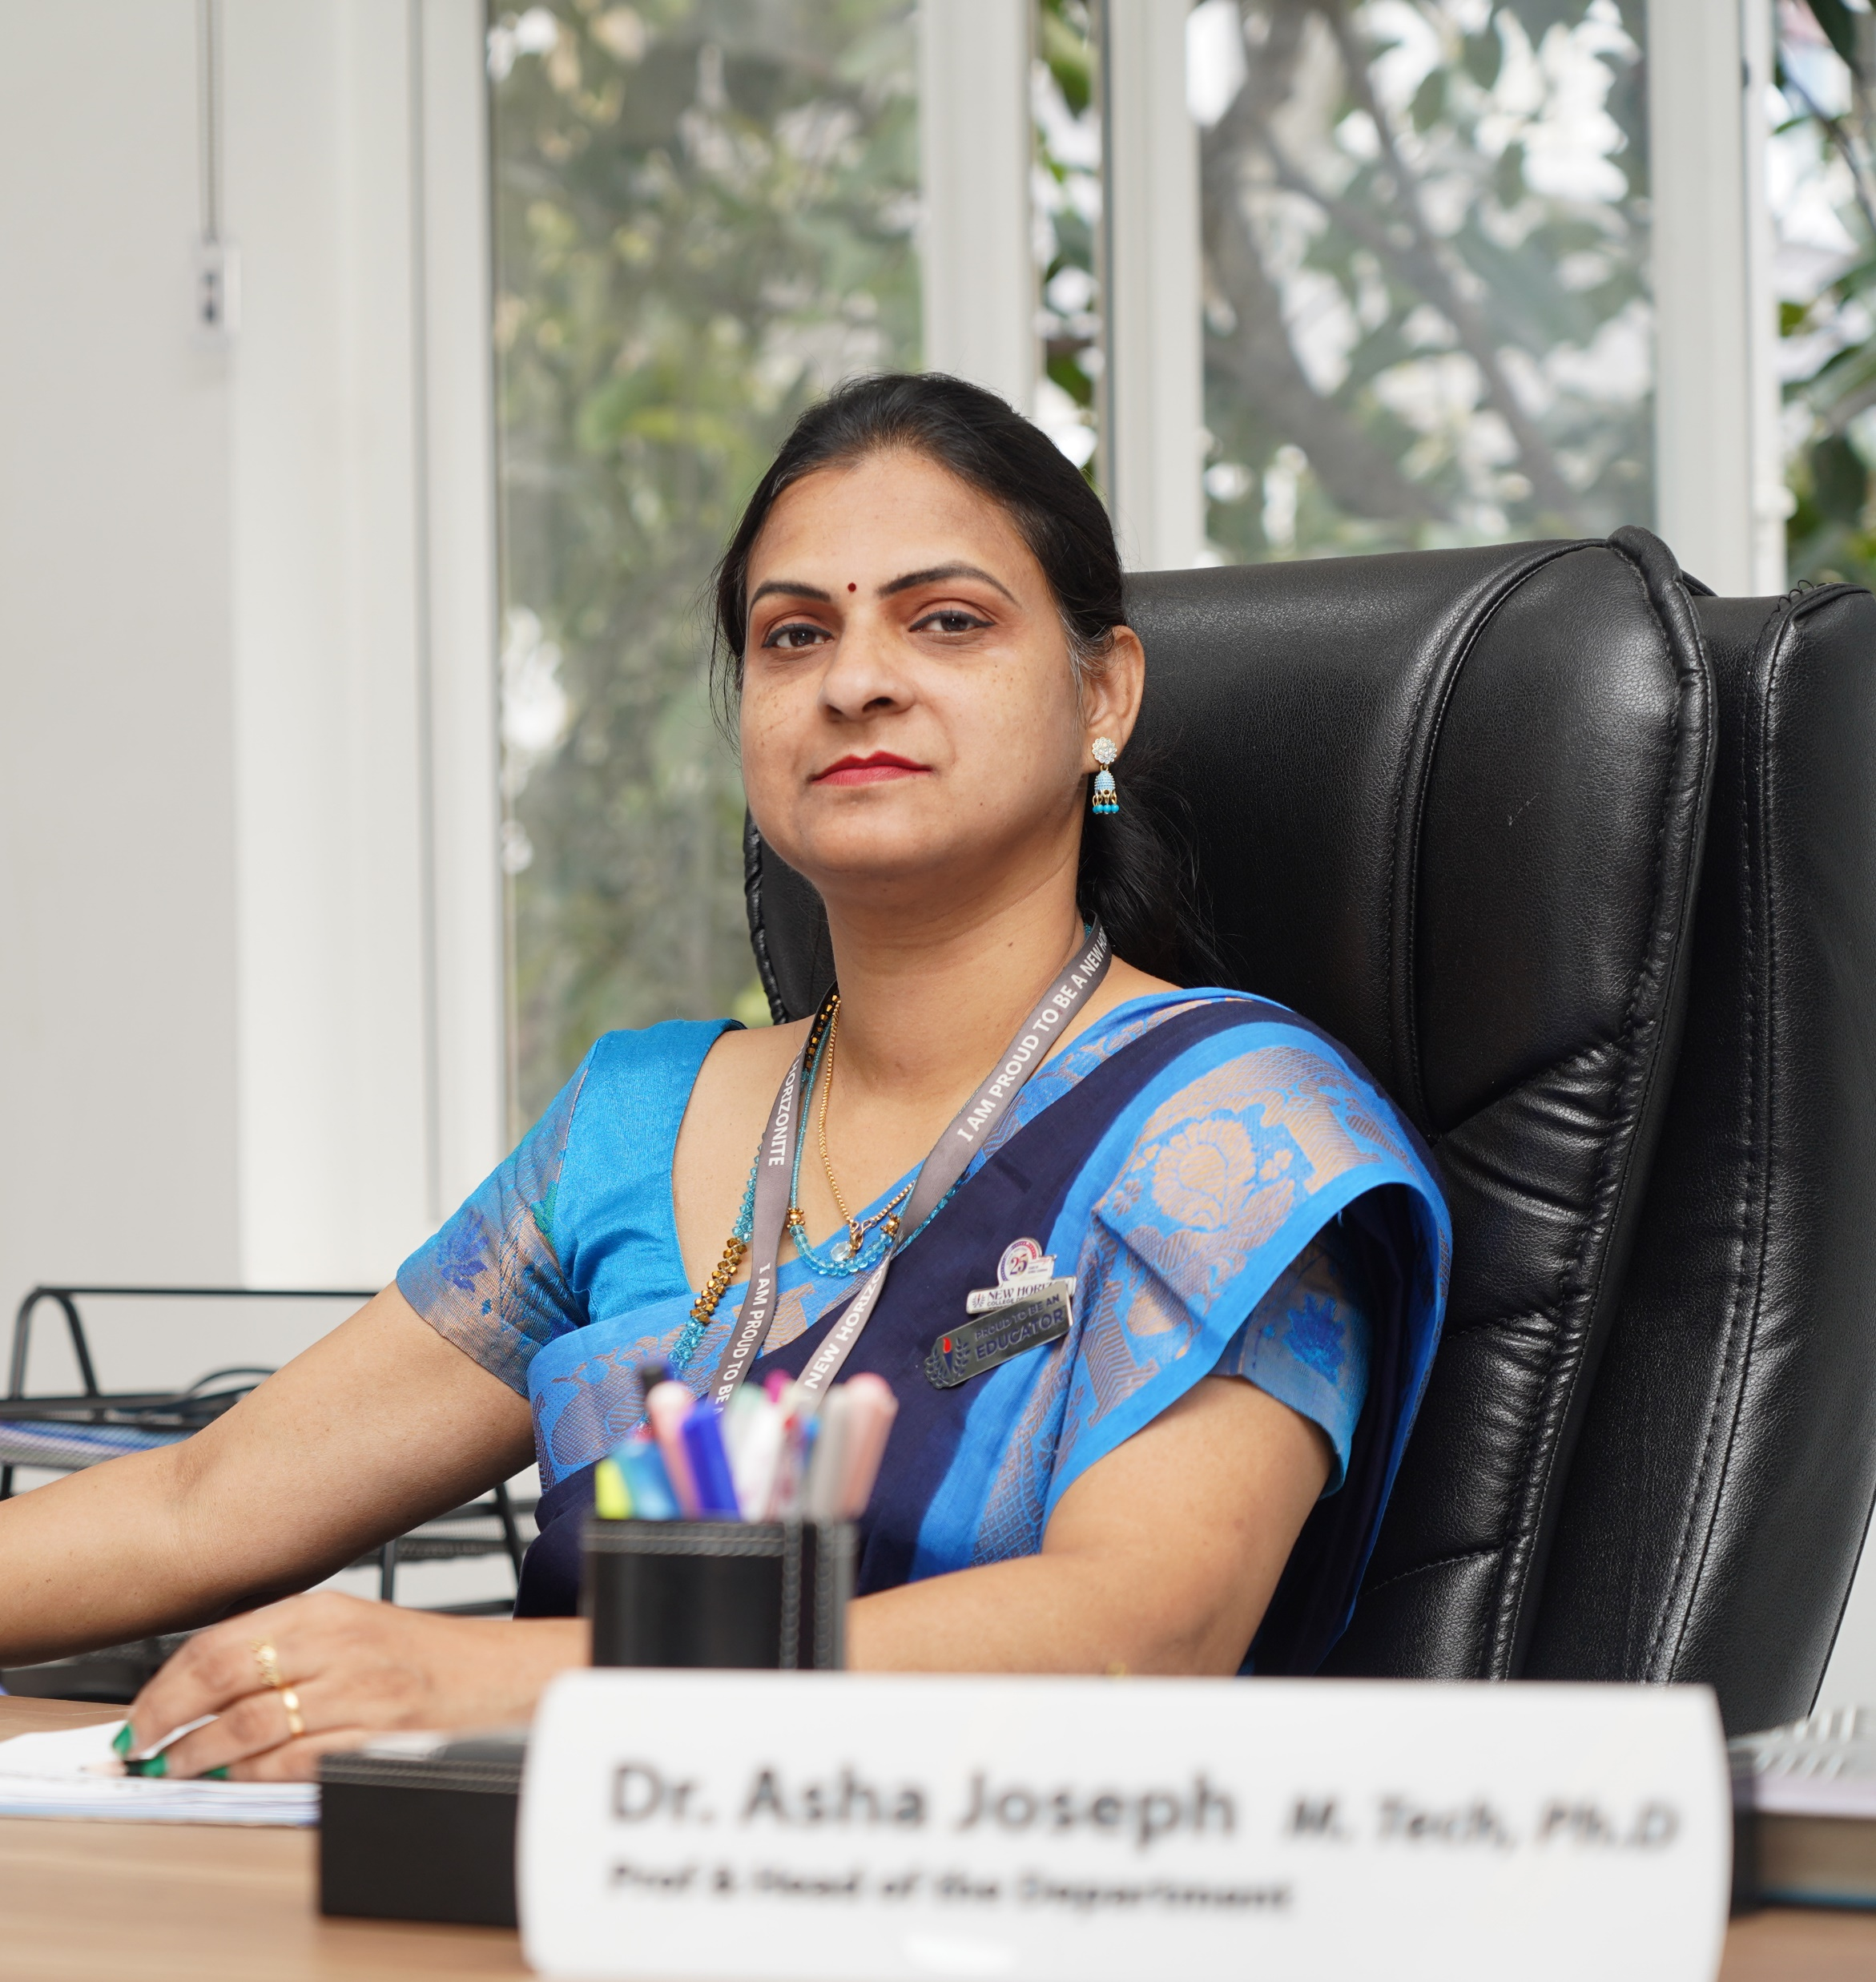
HOD-2 Profile
Dr. Asha Joseph
B.Tech, M.Tech(1st Rank), Ph.D, Post Doctoral Fellow-JCU(PDF)
Area of Research – Operating System Security
28 years of teaching, research and industrial experience
Professional membership – Senior Member IEEE, CSI, Life Member ISTE, Member - National Cyber Safety Security and Standards(of India), Academic Panel Member - Cambridge University Press.
Third Person from all over India to complete Ph.D in the field of “Digital forensics”, Outstanding Ph.D work appreciated by the external examiners, and Patent Granted for the Ph.D work.
Research Expert, Springer Nature - Shift Insight UK, Research Expert, Cambridge University Press, UK.
Research Guide for many Ph.D Scholars
IEEE Xtreme16.0, IEEE as Proctor & Ambassador, CodexPro Mentor, IEEE
AICTE as NEAT Expert Committee Member - National Team in the year 2022
BEST paper awards for many International Conferences, Authored several Books and Chapters
Resource person, Invited Speaker and conference chair for many programs and Conferences
Judge for Finastra International Hackathone, London
Reviewer and Editorial board member for many journals and publishing houses.
Rashtriya Vidya Gaurav Puraskar Award, Certificate of Outstanding achievement in the field of Education, 2016., awarded by Indian Solidarity Council, Govt of India , Rashtrapathi Guide Award in 1991 for Girls Scouts from President of India

Slide 4
PROGRAMMES OFFERED
B.E – Computer Science & Engineering
M.Tech - Computer Science & Engineering
Ph.D in Engineering

Slide 5
Strengths of the Department
Faculty development and enrichment programs
Books published by faculty and ISBN numbers
Faculty conference and journal publications
Research grants received by faculty
Patents filed and received by faculty and students
Industrial MOU’s signed
MOOC certification by faculty and students
International recognition for students
Industry expert lectures
Foreign Language Courses and Student Exchange programs

Slide 6
Strengths of the Department
Entrepreneurship development programs
Alumni get-together
Project exhibitions / competitions
200+ research papers of faculty / students published in Scopus Indexed Journals
Regular Parent Teaching Meeting
Awareness program on IPR under NIPAM
Faculty NPTEL Awards
Highly matured teaching and mentoring environment
Professional society activities

Slide 7
Events conducted in the Department
6th National Conference on "Advancements in Computer Science & Engineering," in association with CSI and IIC
Received 99 papers across diverse domains such as Machine Learning, Healthcare Applications, Blockchain, NLP, IoT and Quantum Computing
Academic consultancy activities
Mini Project Competition
NHCE-CSI Student Chapter -> coding contest
Exposure and field visit on problem identification
Motivational talks & Alumni Talks
Social outreach programs and Industrial Visits
Hands-on workshops on emerging technologies like Data Analytics, Advanced database.

Slide 8
Emerging Technology Courses
Robotics and Automation
Basics of Electric Vehicles
Fundamentals of Internet of Things
Drone Technology
Fundamentals of Cyber Security
Nano Technology
Renewable Energy Sources
Generative AI and Prompt Engineering
Data analytics using R Programming
Ethics In AI

Slide 9
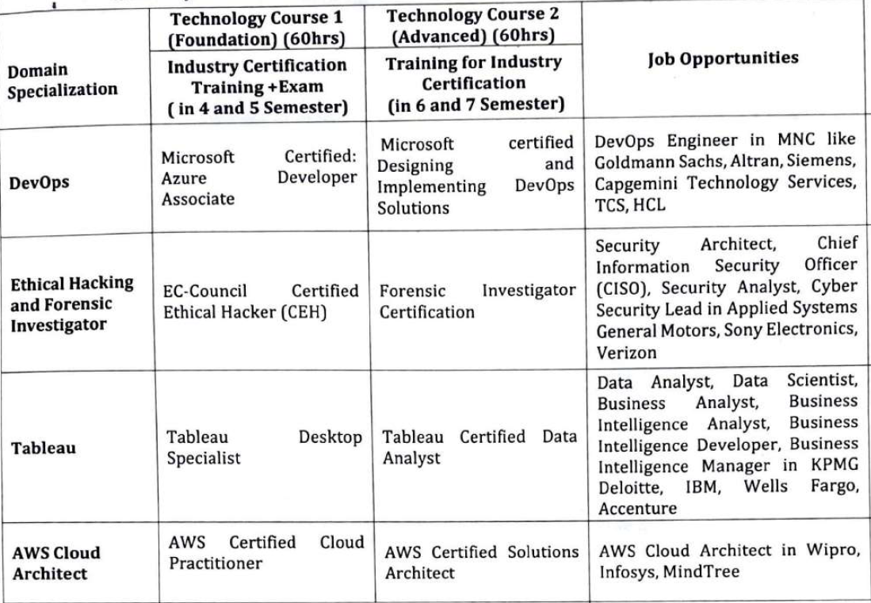
Industry Certification Based Value Added Courses

Slide 10
Industry Certification Based Value Added Courses

Slide 11
Students Mentoring & Other Key Differentiators
Each student is assigned to a mentor
Mentoring records are maintained and confidentiality is maintained
Progress is individually monitored
Certified professional counselor

Slide 12
Club Activities
BIT Club (Business and Information Technology)
MAD Club (Mobile Application Development)
HealthXL Club
TeDeX Talks
QuantumX Fest

Slide 13
Placement Training Through Value-Added Programs
Aptitude training practice by highly qualified industry experts
Soft Skill training
Employability index mapping workshop
Interview facing training programmes
Group discussions
Exclusive CV writing workshop
Comprehensive technical training
Behavioral and personality development training programs

Slide 14
List of our Prestigious Recruiters
Intelligent science Co. Ltd (Japanese International Offer) | Crimson Logic | IBM India | Rubrik
Zscalar | IBS Fintech | KPIT | Oracle
Plan B (Japanese International Offer) | Epsilon | Carelon Global Solutions | Epicor Software India Pvt Ltd
Nvidia | Musigma | Evertz India Pvt Ltd | Dish Network Technologies India
DE-Shaw & Co | Cinepebble | DXC Technology | Nokia
DNP Information System (Japanese International Offer) | Cubic Logic | Tata Consulting Engineers | Whatfix
Vebuin (Japanese International Offer) | Plan source | Accenture | 09 Solutions
Pictgram (Japanese International Offer) | Netradyne | ITC Infotech | ESKO
TOYOTA Connected | Tanla Platforms | UST Global | Sirius
Junglee Games | Capgemini | L&T Technology Services Ltd | Surya Software Systems Pvt.Ltd
Xperi | Global Logic | Cowrks | Computacenter (India) Pvt. Ltd.
Eurofins IT Solutions | Fintellix | Microland | Ernst & Young
Manifest | Health Asyst | Fintellix-Phase 2 | SAP Labs
Ocwen Financial | Intrainz | Fidelity National Financial India | Societe Generale
Spektra Systems | LG Soft | Accrete Globus Technology | CGI
Western Digital | Lead Squared | Joveo | Sacha Engineering
Aurigo Software Technologies Pvt. Ltd | GrayMatter Software Services Pvt Ltd | Smarsh | LTI MindTree

Slide 15
Placement Status of 2025 Batch students
Total number of students opted for placement | 267
Total number of offers | 248
Number of students placed | 209
Number of International Offers | 3
Number of students yet to be placed | 58
Placement percentage | 78.27 %

Slide 16
Alumni
Alumni Meets
Alumni as jury for competitions and Hackathons
Alumni interaction with students
Alumni involvement in placements
Alumni Contribution in BoS
Motivational Talks by Alumni
Career Guidance Talks by Alumni

Slide 17




THANK YOU
For more information, please contact
Phone: 080-66297777
E mail: admissionsnhce@newhorizonindia.edu
Website: www.newhorizonindia.edu
Follow us on:

